Slide 1


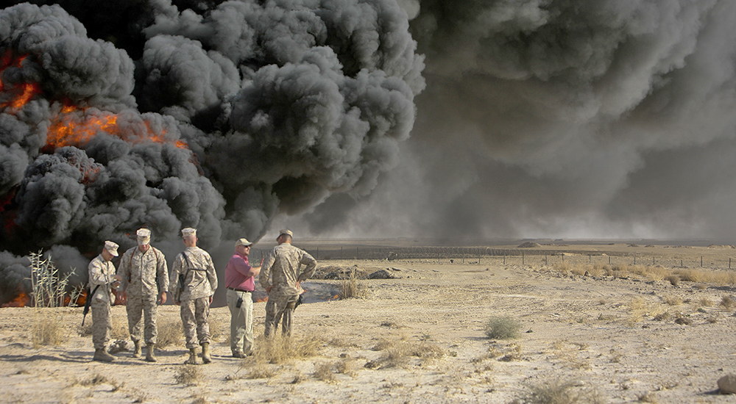
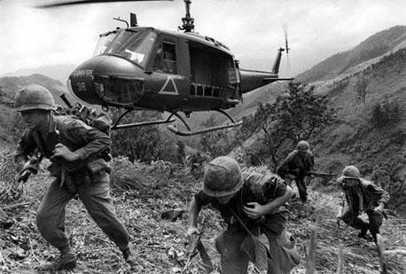
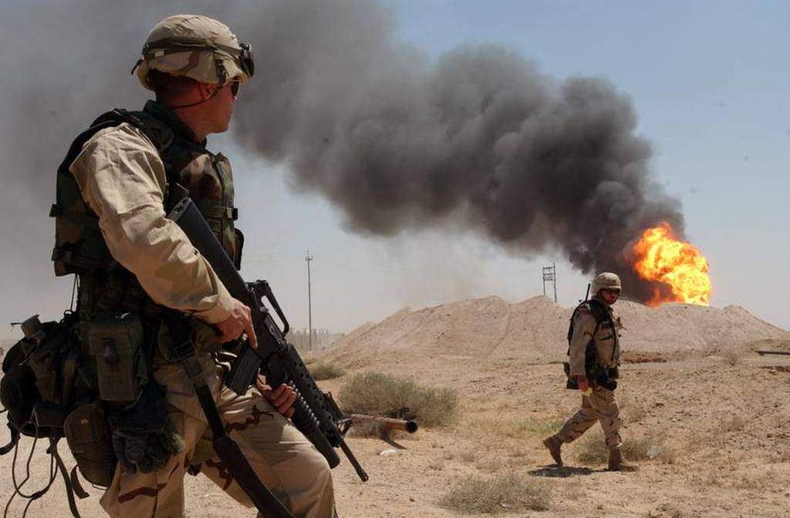
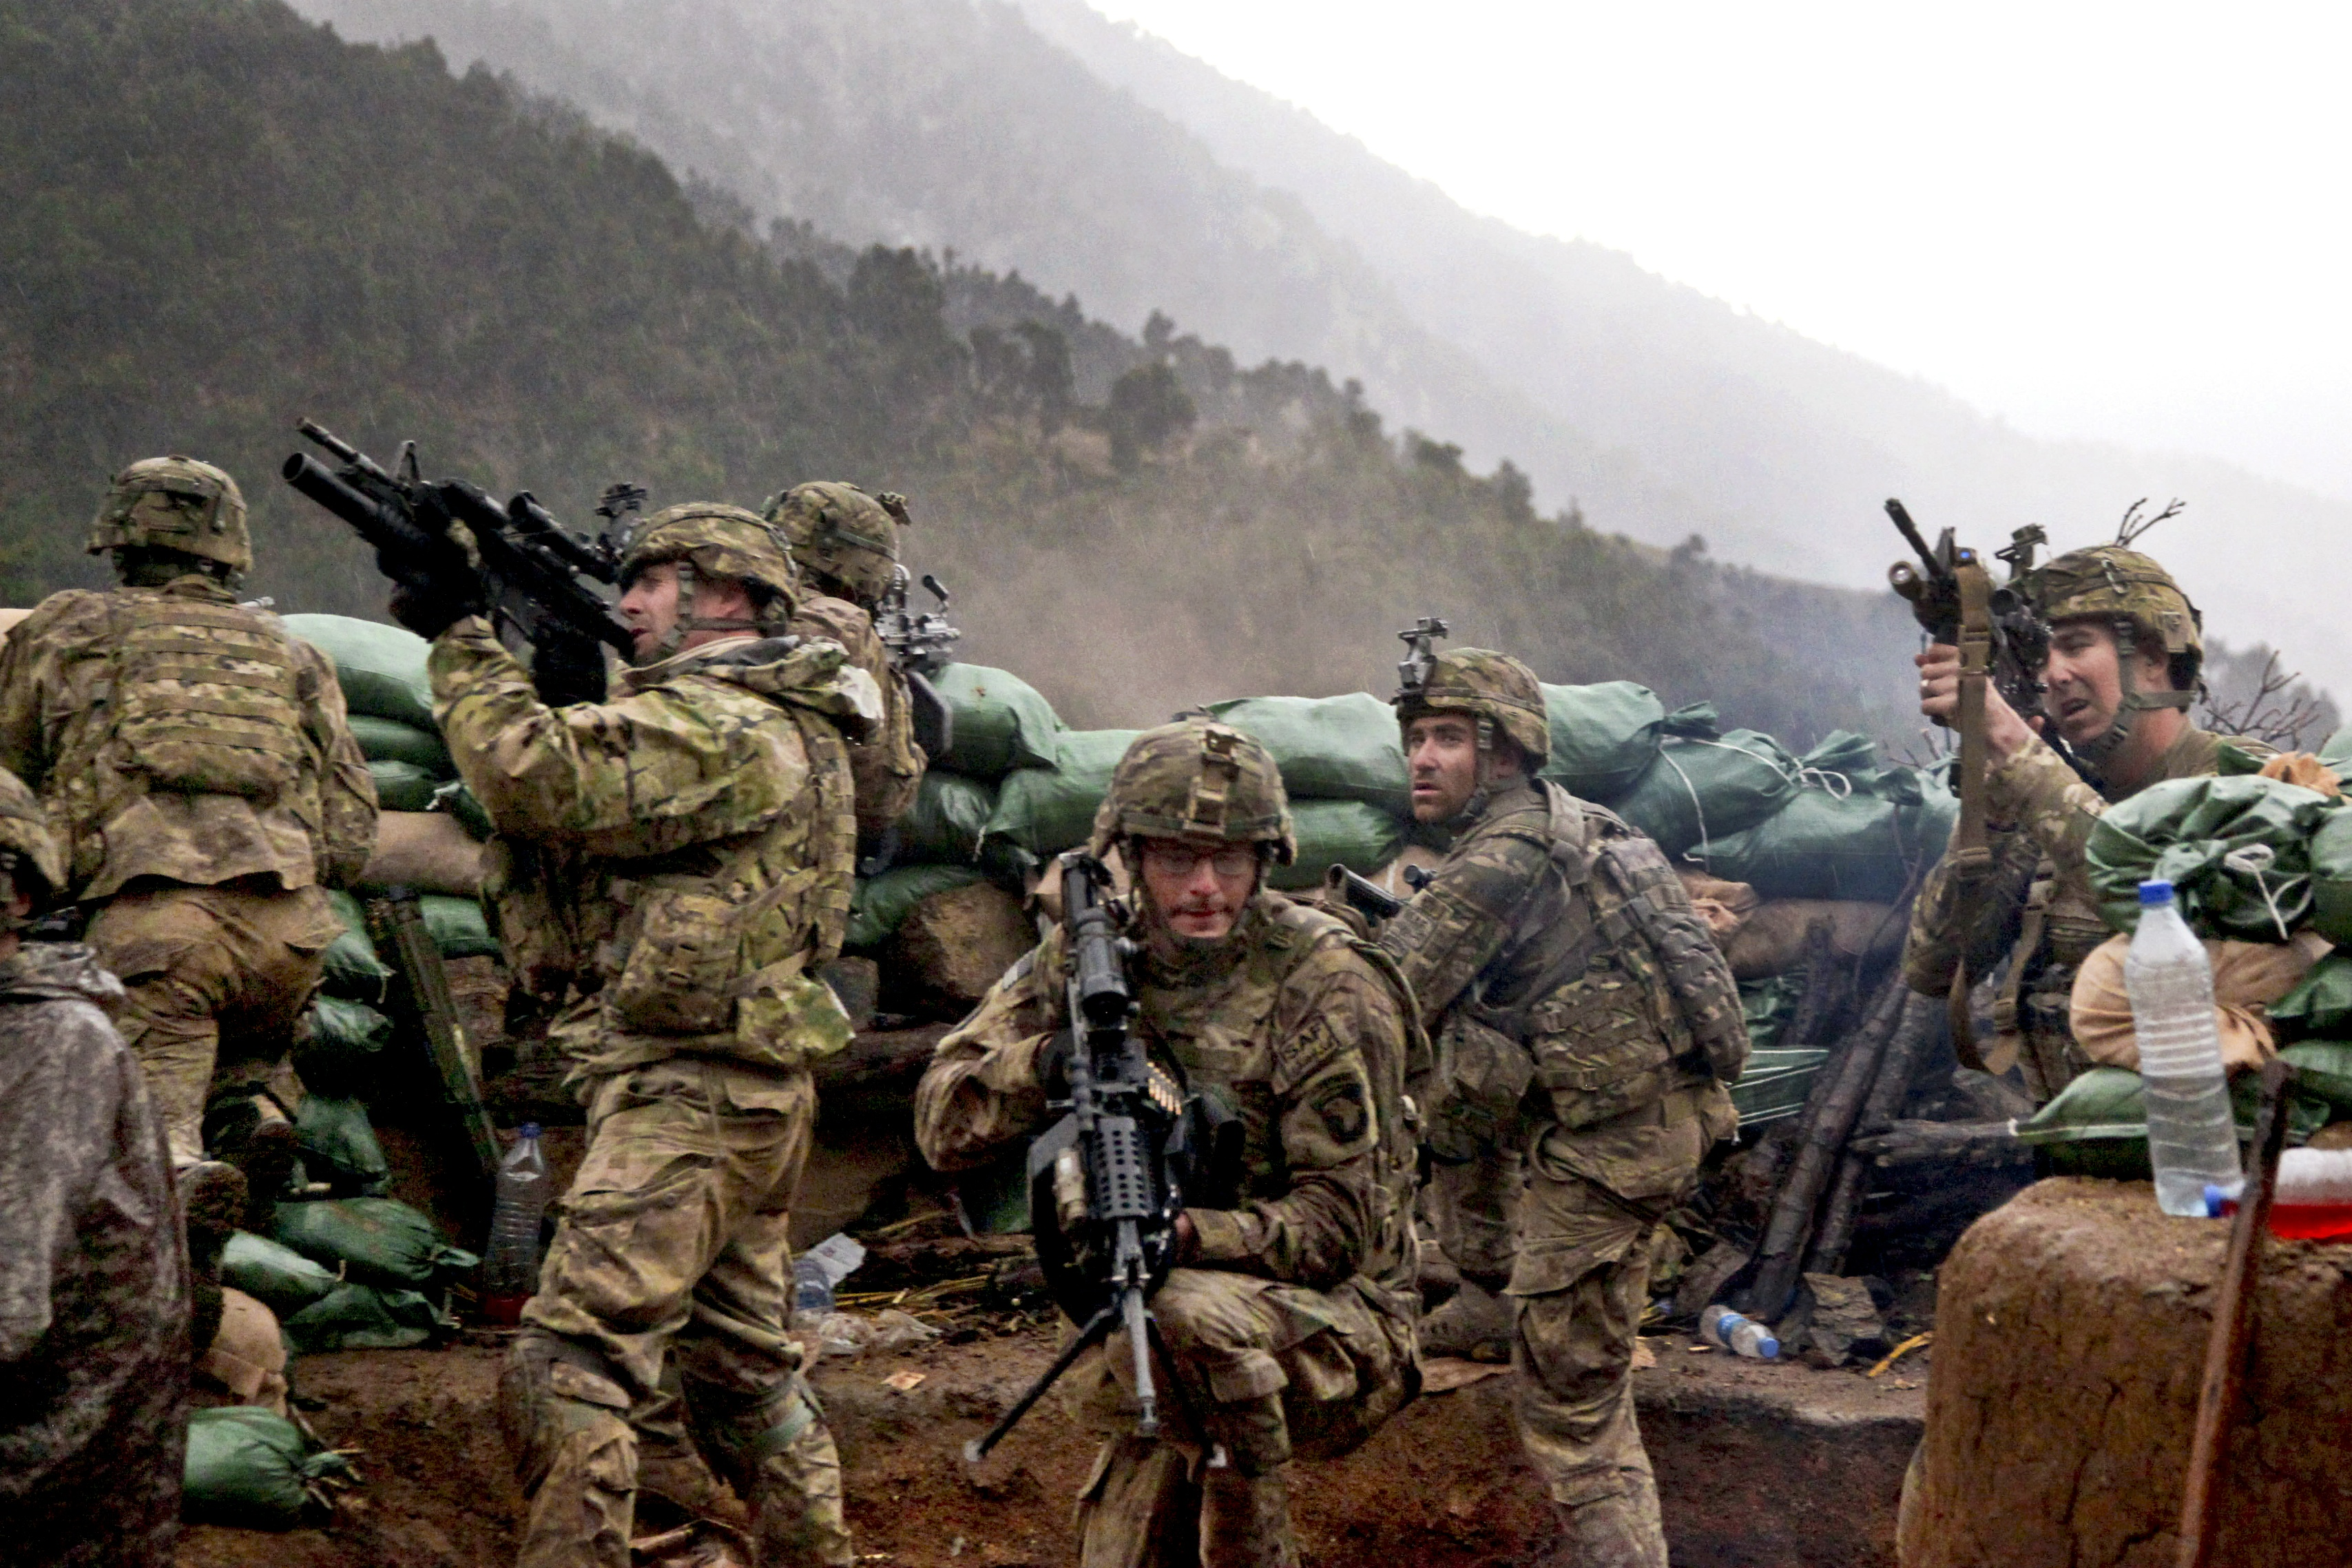
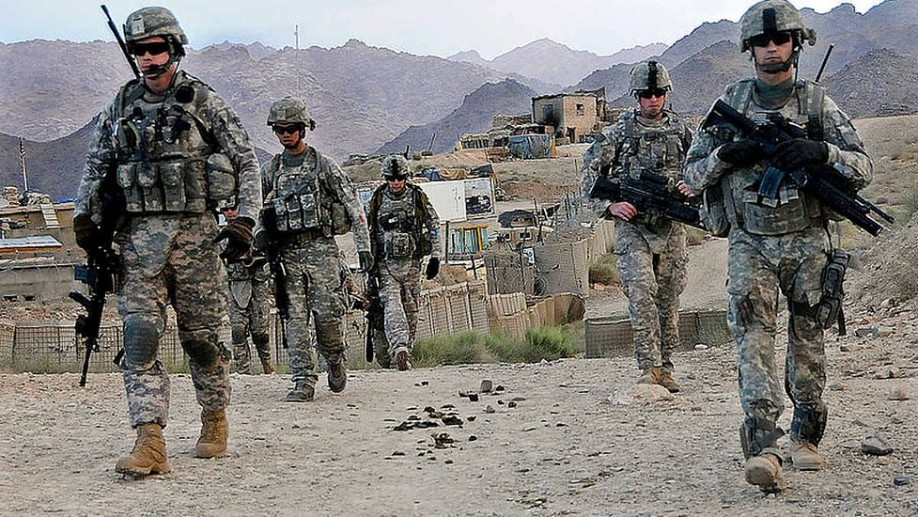

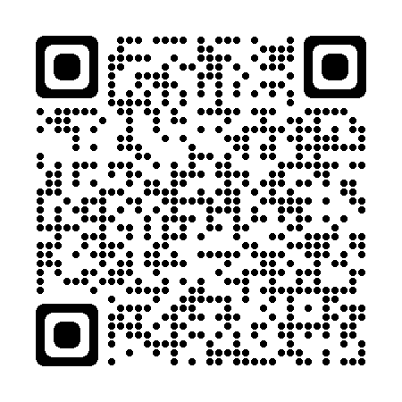


CALLING ALL VETERANS
PACT ACT
Agent Orange/Burn Pit/Toxic Substances
Vietnam
Gulf War Era
Post-9/11 Afghanistan and Iraq
Veteran Registration Rally
4 April 2023
10:00 AM to 3:00 PM
KSU Center Ballroom
What to bring:
DD 214  Identification
ANY supporting documents  Medical Records
Nexus Letter (if you have one)

